Slide 1
News Media Coverage
Student’s Name
Institution Affiliation
Instructor’s Name
Date of Submission

Slide 2
Introduction
The ‘black man’ has been harassed, oppressed, mistreated, and killed mercilessly in numbers for years.
Recently, the murder of George Floyd has brought about massive rage from all the global community.
The media have been at the forefront to cover the massive protests that have been witnessed all over the globe.
This presentation focuses on the media coverage in America, Canada, and the eastern countries on “Black Lives Matter” and how the media impacts the perception of situations and their comparison to see the differences and the similarities.
Notes:
For years the black man has been oppressed, mistreated, and killed mercilessly in their numbers. The slavery of the black man, which lasted for centuries, is just one way the system continues to harass marginalized groups. The killing of these individuals has had a long history, even in recent times. The murder of innocent marginalized individuals has been witnessed in the past decades, and in most instances, the killers end up free. In recent times the murder of George Floyd has brought about massive rage from the global community at large. Police murdered George Floyd in broad daylight despite being unarmed. Other victims include Brianna Taylor, murdered at her house during an ongoing operation. These deaths are just but a few of the atrocities carried out on the black man, but it has brought about a global reaction. Massive protests have been witnessed all over the globe, people coming together and standing up against oppression. This is a significant step towards change, and the demonstrations have indeed made an impact.

Slide 3
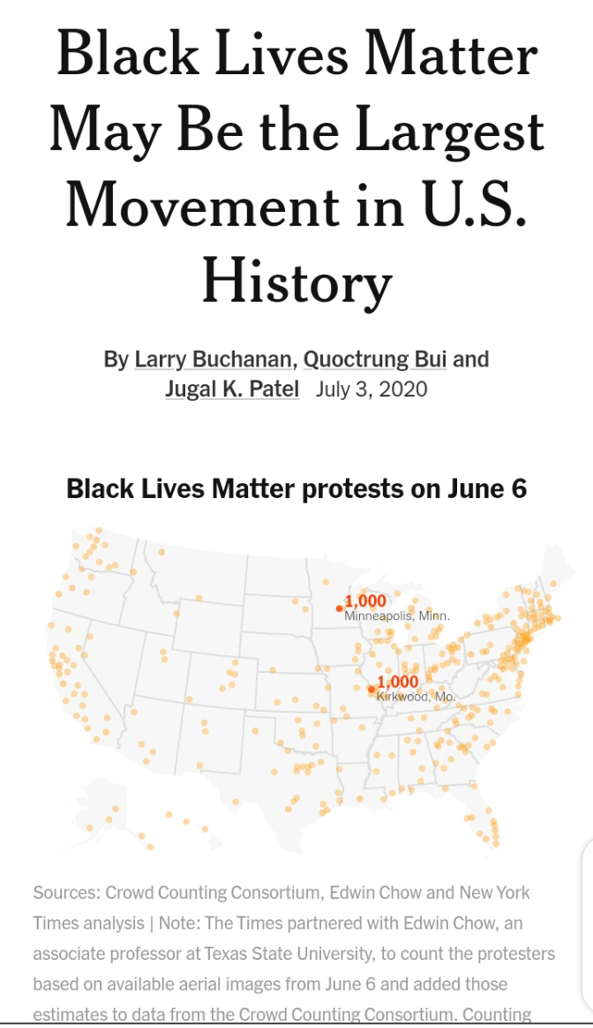
New York Times Coverage
All the media centers covered the news on the "black lives matter" in America.
The New York Times article gave its perception of the issue in their language.
Larry Buchanan wrote the item along with his counterparts in July 2020.
It starts by providing a glimpse of the ongoing protests identifying the places and number of protestors, then it goes ahead and dwells in research on the issue.
Notes:
In this article, we shall see the effect of media coverage in America, Canada, and the eastern countries on “Black Lives Matter” how the media impacts the perception of situations and their comparison to see the differences and the similarities. In a modern world that has integrated technology into our day to day lives, this has left media houses with authority to create perceptions on issues to the public. The news aired daily provides information on various occurrences of the day; people rely on them for information. A hazardous role when left in the wrong hands, we see how the media can alter perceptions of situations to their benefit or that of their superiors. Firstly, we look at the news media coverage on the "black lives matter" in America. The New York Times article gives its perception of the issue in their language. Larry Buchanan wrote the item along with his counterparts in July 2020. It starts by providing a glimpse of the ongoing protests identifying the places and number of protestors, then it goes ahead and dwells in research on the issue.

Slide 4
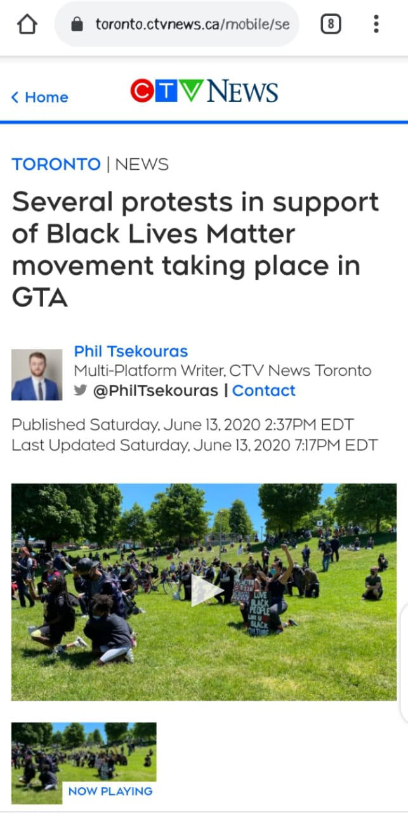
CTV News Toronto
This is a Canadian news coverage on the "Black lives matter" written by Phil Tsekouras on June 13th, representing CTV news based in Toronto.
It highlights some of the reasons for the protests for ‘Black Lives Matter’ in the United States and across the world.
It also describes a number of protesters who were in support of the ‘Black Lives Matter’ across the greater Toronto area.
Notes:
The Canadian news coverage on the "Black lives matter" was written by Phil Tsekouras on June 13th, representing CTV news based in Toronto. We want to look at how they portray their perspective on the issue.
The CTV news based in Toronto highlights some of the reasons for the protests for ‘Black Lives Matter’ in the United States and across the world. They added that it was as a result of the deaths of Ahmaud Arbery, Breonna Taylor and the late George Floyd. They also tried to describe a number of protesters who were in support of the ‘Black Lives Matter’ across the greater Toronto area. They also gave a reason that propelled the protests by describing Floyd’s words “I can’t breathe” and exact location where the incidence happened and the date. They researched on the place where the first demonstration started and by how many participants where it started at Christie Pits Park with hundreds of participants making their way to Queen’s Park.

Slide 5
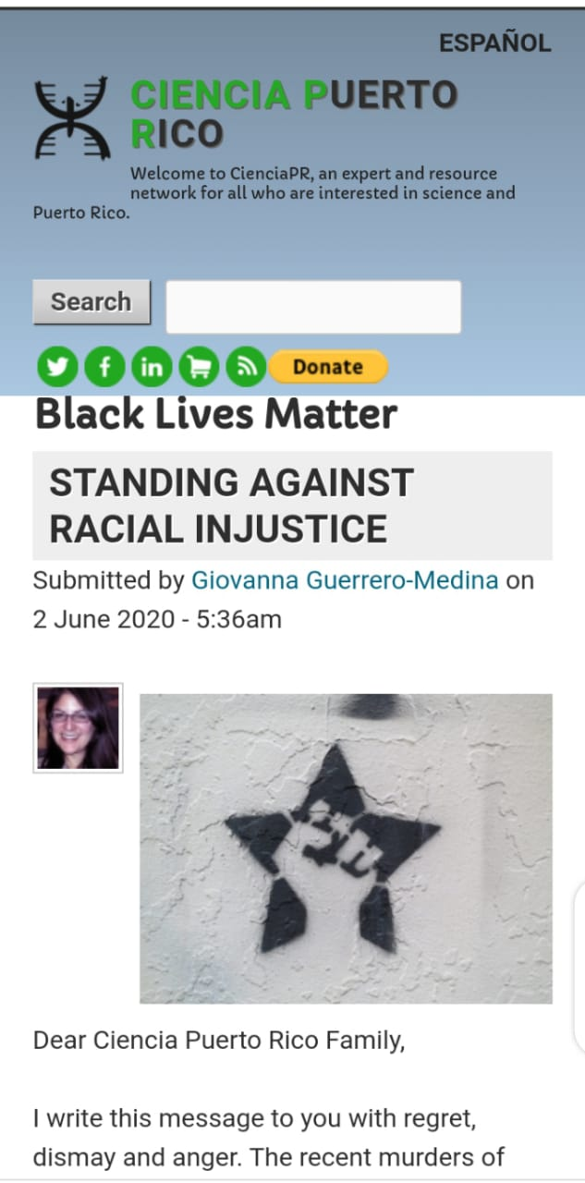
Ciencia Puerto Rico Coverage
The Puerto Rican coverage on the subject was written by Giovanna Guerrero in June 2020.
It gives a personal perspective into the issue.
The author portrays the tone that seems to back up the protesters; this author shows bias as he has picked the protesters' side.
There is a big difference between these media houses and how they create perceptions about various issues in our day-to-day lives.
The similarity between the American and Canadian news coverage is that they seem to hold back on the proper scope of the protests, the purpose, and the reaction they are getting.
Notes:
Lastly, we look at the Puerto Rican coverage on the subject; Giovanna Guerrero wrote the article in June 2020. The Puerto Rican news coverage, however, gives a personal perspective into the issue. The author portrays the tone that seems to back up the protesters; this author shows bias as he has picked the protesters' side. Therefore, there is a vast difference between these media houses and how they create perceptions about various issues in our day-to-day lives. The similarity between the American and Canadian news coverage is that they seem to hold back on the proper scope of the protests, the purpose, and the reaction they are getting.

Slide 6
Similarities and Differences
The first two articles shows the media coverage of the protests as a movement.
In the New York times, they even compare the movement to those who have tried to overthrow governments.
The image they seem to portray is entirely wrong and cynical about the issue.
A reader reading the article will have the wrong concept of the protest and may take them as law offenders.
Notes:
In the first two articles, the media coverage shows the protests as a movement; they say that the movement is rising each day, spreading to many places. They are emphasizing that the protestors include people of all races. In the New York times, they even compare the movement to those who have tried to overthrow governments. The image they seem to portray is entirely wrong and cynical about the issue. A reader reading the article will have the wrong concept of the protest and may take them as law offenders.

Slide 7
Cont..
To understand the comparison between these media news coverage between these three countries, we look at each article and observe the similarities.
The American and Toronto media houses seem to have a parallel in the dullness of their information.
The authors' tone is similar, and they give very blunt statements about the protests' actual purpose.
They highlight the population of the demonstrations and the areas where the protests have been noticed.
Notes:
To understand the comparison between these media news coverage between these three countries, we look at each article and observe the similarities. The American and Toronto media houses seem to have a parallel in the dullness of their information. The authors' tone is similar, and they give very blunt statements about the protests' actual purpose. Instead, they highlight the population of the demonstrations and the areas where the protests have been noticed. They seem to want to downplay the extent of the information.

Slide 8
Cont..
The New York times paid attention on the number of protestors and diverted the much asked question on the current situation and the reforms.
The Canadian media coverage also don’t show things as they are because while reading the article my attention is diverted mainly on the protests and their extents, leaving me stranded from the truth.
The other news coverage seems to be opposed to the normality of the earlier two.
Notes:
The article from the New York times has paid attention on the number of protestors and diverted the much asked question on the current situation and the necessary reforms. The Canadian media coverage too seems to not really show things as they are, reading the article my attention is diverted mainly on the protests and their extents, leaving me stranded from the truth. The other news coverage seems to be opposed to the normality of the earlier two. All this is just an example of how the media houses are used to brainwash the public with miscommunication.

Slide 9
Perception Before reading the articles
Before I read the articles, I believe that human rights are meaningful and should be considered anywhere.
It strikes me that some human beings do not believe in equality for all.
These articles published by the media houses were meant to misinform the public and confuse them.
This is evidence of how mental slavery is very real and being transmitted through these media coverages.
Notes:
As a firm believer in every human being's rights, it strikes me that some human beings do not believe in equality for all. These articles published by the media houses were meant to misinform the public and confuse them. This is evidence of how mental slavery is very real and being transmitted through these media coverages. The politicians or those in power mislead the public as they downplay the issues such as institutionalized racism, which continue to bring injustice to the marginalized groups.

Slide 10
Perception After reading the Articles
After reading these articles, my perception of the situation has not changed.
But for many that rely on news media to get their information, they might not be as lucky.
People need to wake up and end all injustices and bring equality to everyone once and for all.
Notes:
After reading these articles, my perception of the situation has not changed, but for many that rely on news media to get their information, they might not be as lucky. People need to wake up and end all injustices and bring equality to everyone once and for all.

Slide 11
References
Guerrero. G. M (2 June 2020). Ciencia Puerto Rico. Black Lives Matter. STANDING AGAINST RACIAL INJUSTICE. Retrieved from: https://www.cienciapr.org/en/tags/black-lives-matter
Tsekouras. P. (June 13, 2020). Multi-Platform Writer, CTV News Toronto. Several protests in support of Black Lives Matter movement taking place in GTA. Retrieved from:
https://toronto.ctvnews.ca/mobile/several-protests-in-support-of-black-lives-matter-movement-taking-place-in-gta-1.4983062
Buchanan. L, Quoctrung Bui and Jugal K. Patel (July 3, 2020). The New York Times. Black Lives Matter May Be the Largest Movement in U.S. History. Retrieved from: https://www.nytimes.com/interactive/2020/07/03/us/george-floyd-protests-crowd-size.html

